Slide 1
Telecom Churn Case Study

Slide 2
Importing the Dataset
• This telecom dataset has 99999 rows and 226 columns.
HANDLING MISSING VALUE
Let us consider the column date_of_last_rech_data indicating the date of the last recharge made in any given month for mobile internet. Here it can deduced if the total_rech data and the max_rech_data also have missing values, the missing values in all the columns mentioned can be considered as meaningful missing. •Hence imputing 0 as their values. •Meaningful missing in this case represents the customer has not done any recharge for mobile internet

Slide 3
Handling the missing values for the attributes count_rech_2g_*,count_rech_3g_* for month 6,7,8 and 9.
• From the above tabular the column values of total_rech_data for each month from 6 to 9 respectively is the sum of the columns values of count_rech_2g for each month from 6 to 9 respectively and count_rech_3g for each month from 6 to 9 respectively, which derives to a multicollinearity issue. To reduce the multicollinearity, we can drop the columns count_rech_2g for each month from 6 to 9 respectively and count_rech_3g for each month from 6 to 9 respectively.
Handling the missing values
for the attributes arpu_3g_*,arpu_2g_* for month 6,7,8 and 9
• From the above correlation table between attributes arpu_2g_* and arpu_3g_* for each month from 6 to 9 respectively is highly correlated to the attribute av_rech_amt_data_* for each month from 6 to 9 respectively. Considering the high correlation between them, it is safer to drop the attributes arpu_2g_* and arpu_3g_*.

Slide 4
Handling the missing values for the attributes av_rech_amt_data_* for month 6,7,8 and 9
• From the above tabular it is deduced that the missing values for the column av_rech_amt_data_* for each month from 6 to 9 can be replaced as 0 if the total_rech_data_* for each month from 6 to 9 respectively is 0. i.e. if the total recharge done is 0 then the average recharge amount shall also be 0
• Since the columns used to determine the High-Value Customer are clear of null values, we can filter the overall data and then handle the remaining missing values for each column.
Filtering the High-Value Customer from Good Phase
• The 70th quantile value to determine the High-Value Customer is 478.0.
• The total number of customers is now limited to ~30k which lies under the High-Value customer criteria based upon which the model is built.

Slide 5
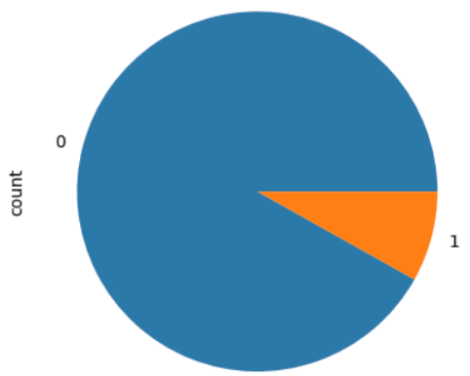
Defining Churn variable
For that, we need to find the derived churn variable using total_ic_mou_9,total_og_mou_9, vol_2g_mb_9, and vol_3g_mb_9 attributes
Churn
0 91.86
8.14
Name: count, dtype: float64
• As we can see that 91% of the customers do not churn, there is a possibility of class imbalance

Slide 6
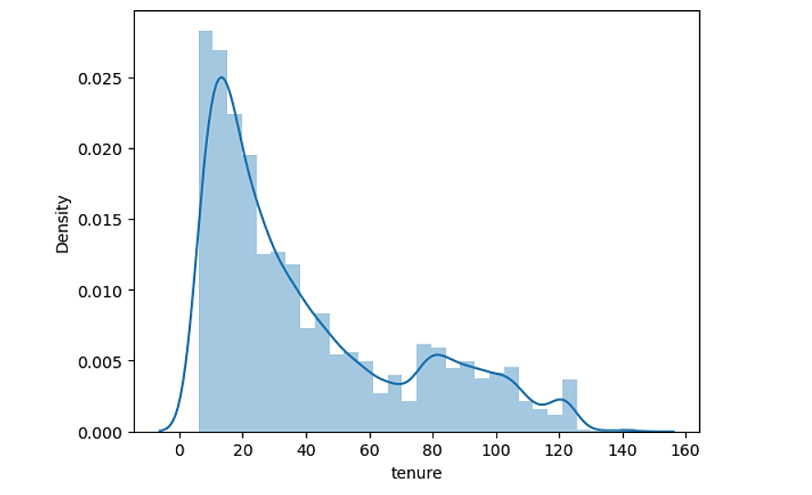
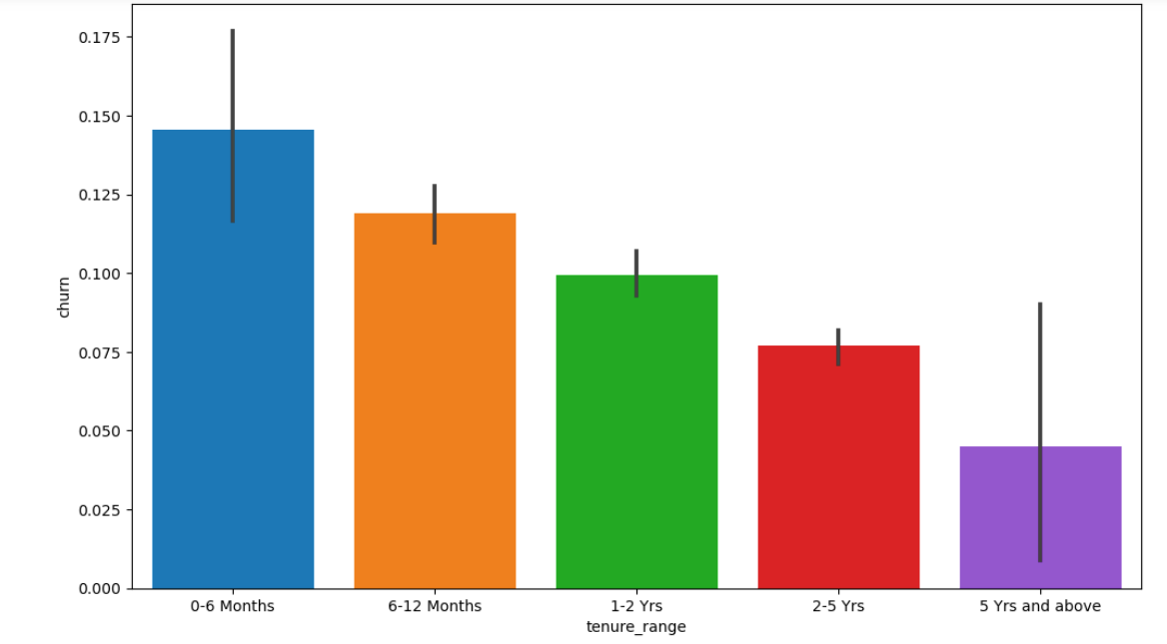
Deriving new variables to understand the data
It can be seen that the maximum churn rate happens within 0-6 months, but it gradually decreases as the customer retains in the network.

Slide 7
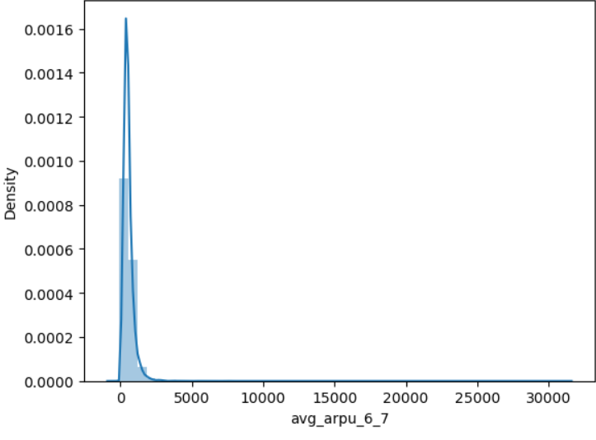
The average revenue per user is the good phase of a customer is given by arpu_6 and arpu_7. since we have two separate averages, let’s take an average of these two and drop the other columns.

Slide 8
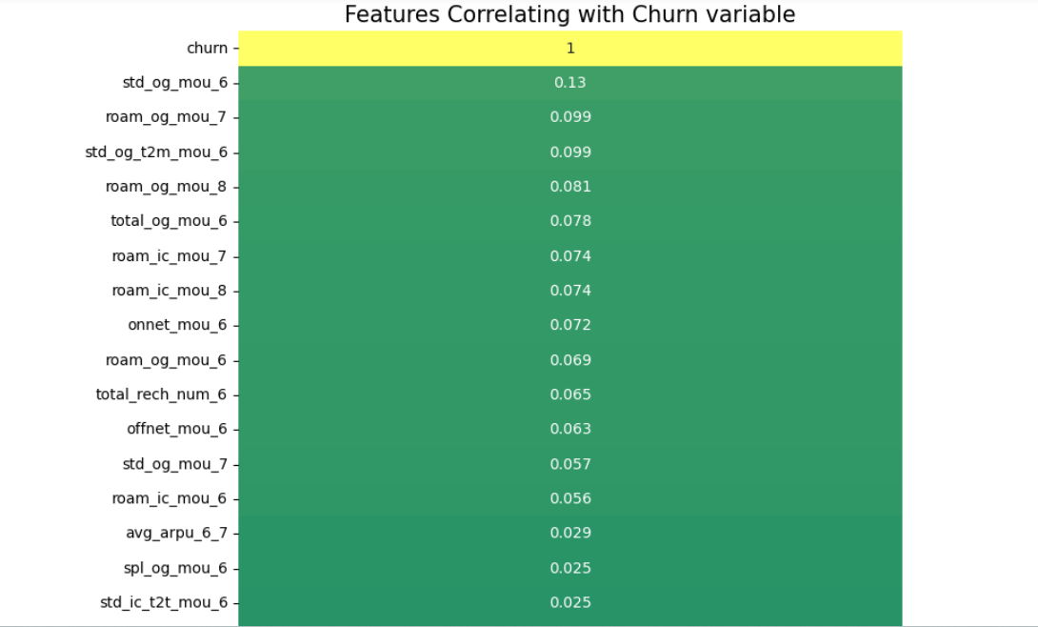
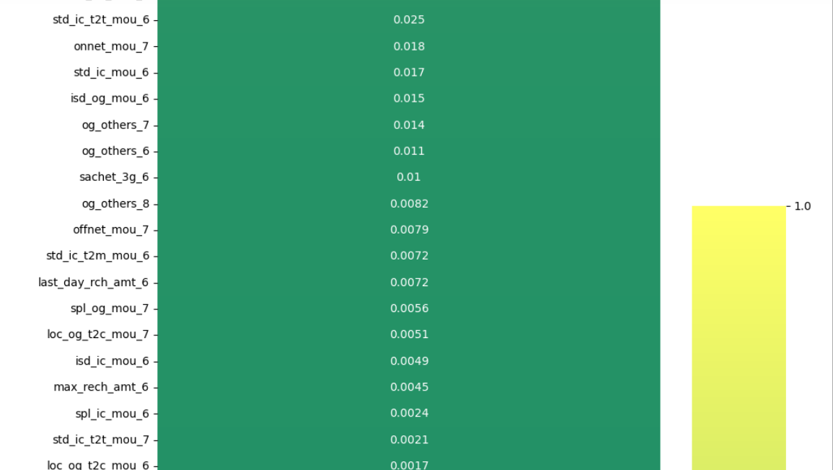
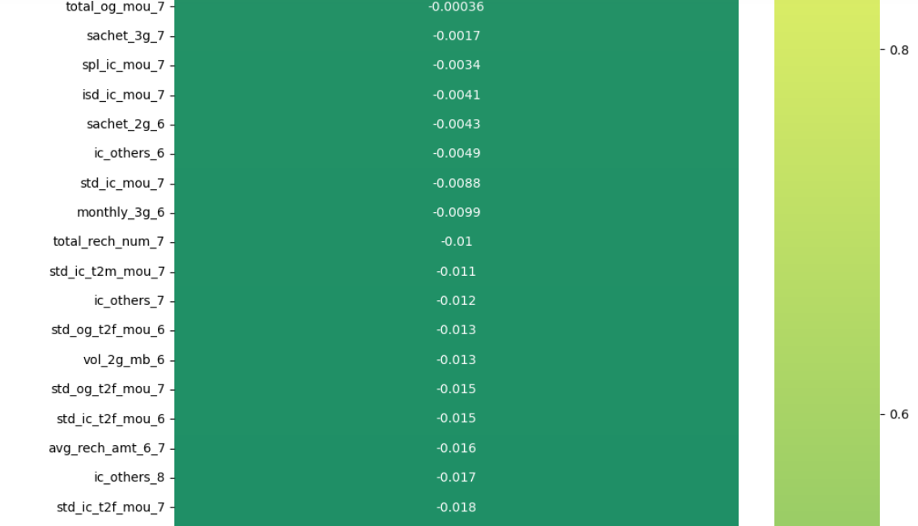
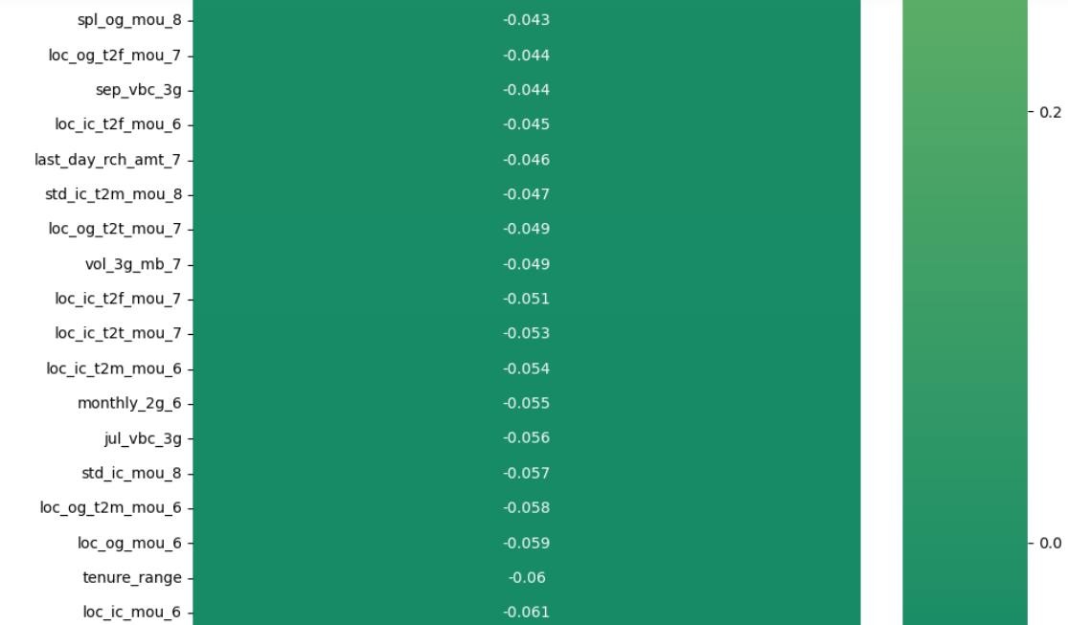
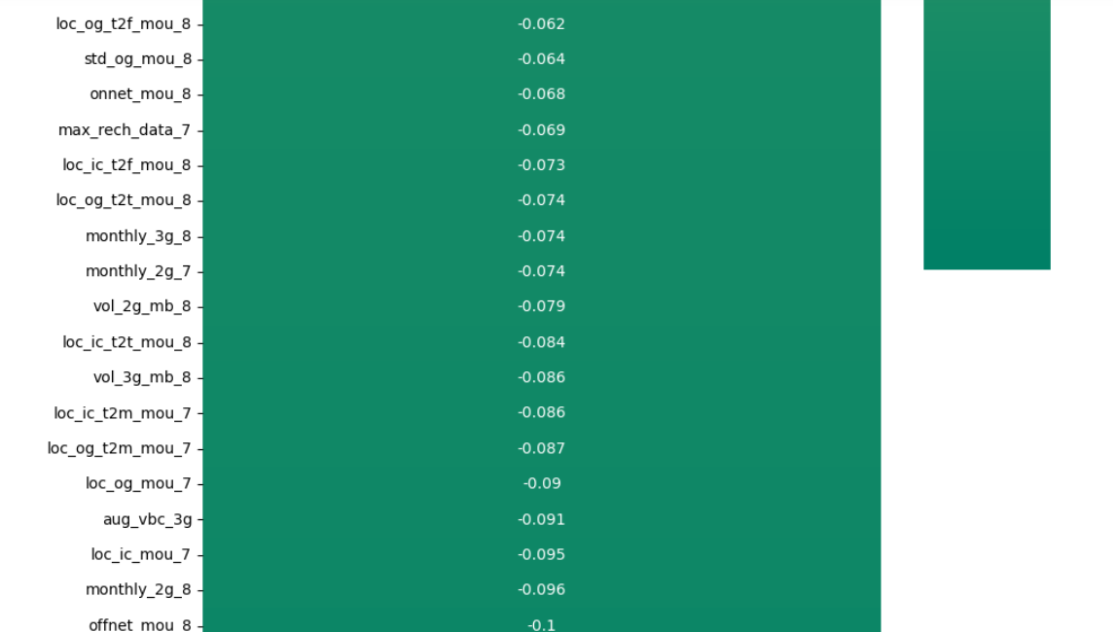
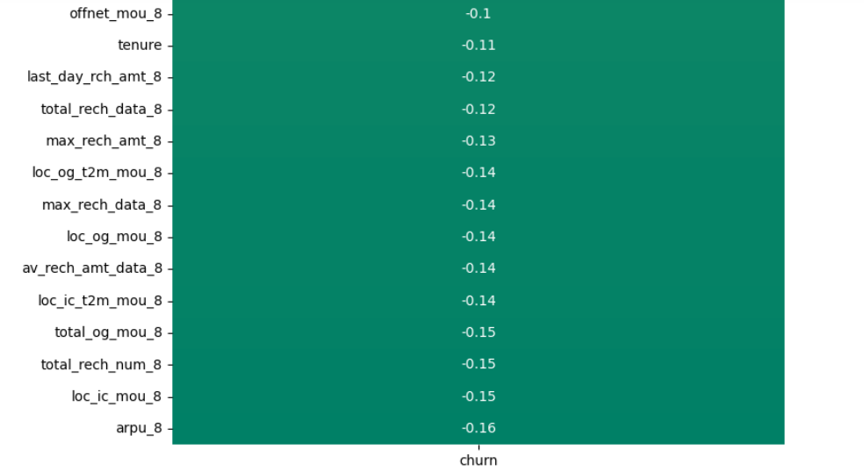
•Avg Outgoing Calls & calls on roaming for 6 & 7th months are positively correlated with churn.
•Avg Revenue, No. Recharge for the 8th month has a negative correlation with churn.

Slide 9
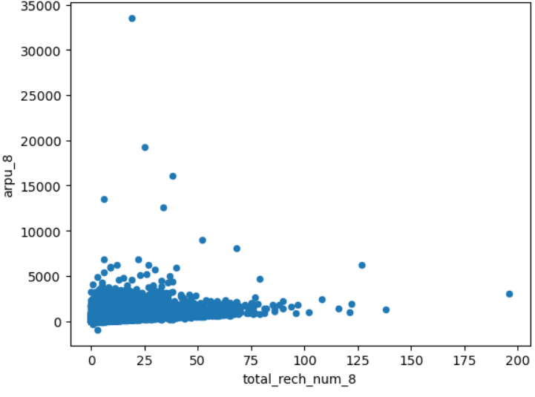
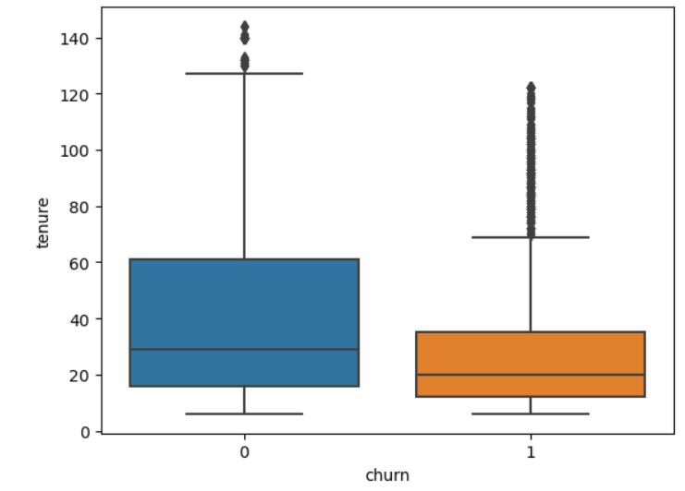
total_rech_num_8', 'arpu_8
• From the above plot, it’s clear that tenured customers do no churn and they keep availing of telecom services

Slide 10
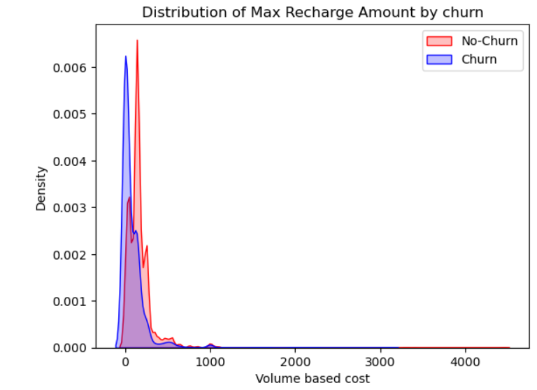
Plot between churn vs max recharge amount

Slide 11
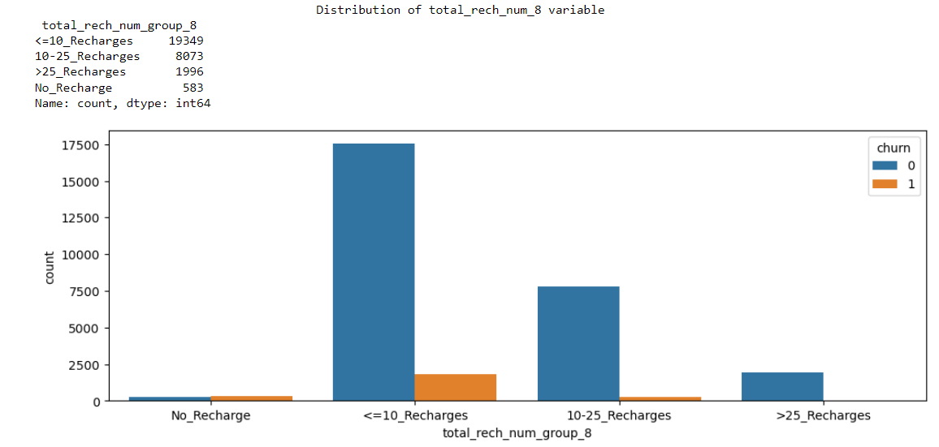
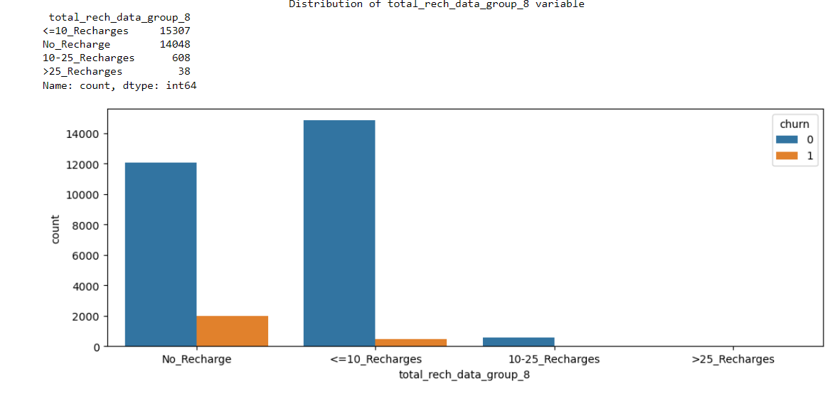
• As the number of recharge rate increases, the churn rate decreases clearly

Slide 12
Data Imbalance Handling
Using the SMOTE method, we can balance the data w.r.t. churn variable and proceed further.
Logistic Regression
• Logistic Regression using Feature Selection (RFE method).
• Assessing the model with Stats Models
• Creating a data frame with the churn flag and the predicted probabilities.
• Metrics beyond simply accuracy

Slide 13
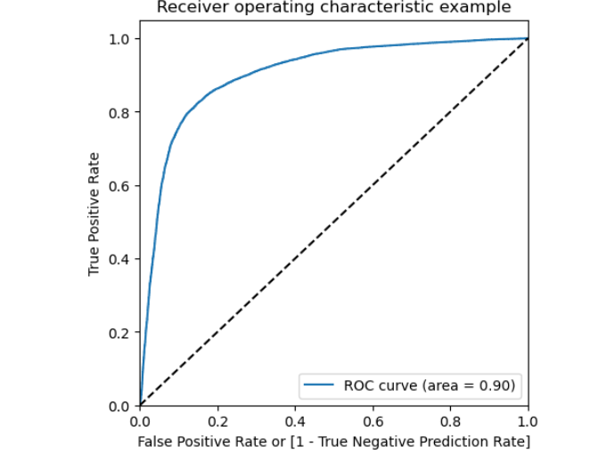
Plotting the ROC Curve

Slide 14
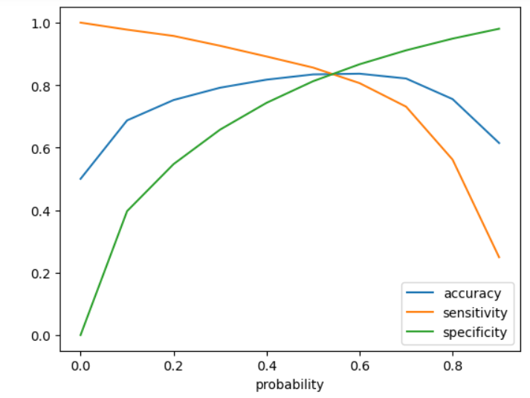
Finding Optimal Cutoff Point
• Initially we selected the optimal point of classification as 0.5.

Slide 15
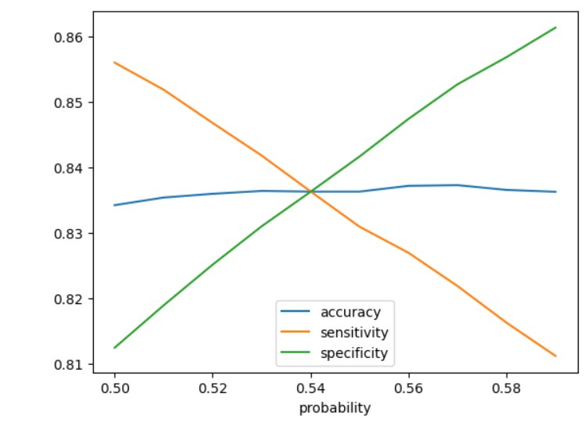
From the above graph we can conclude, that the optimal cutoff point in the probability to define the predicted churn variable converges at 0.54

Slide 16
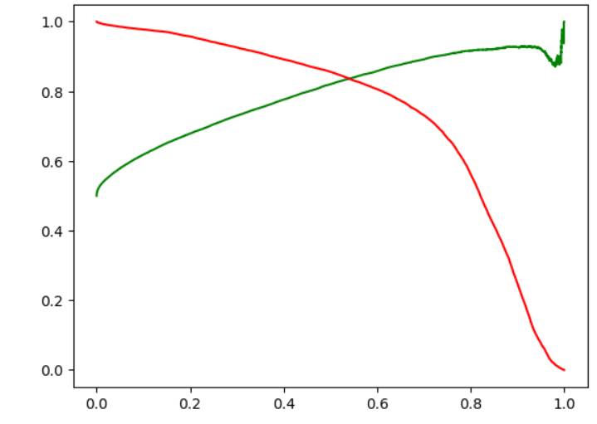

Slide 17
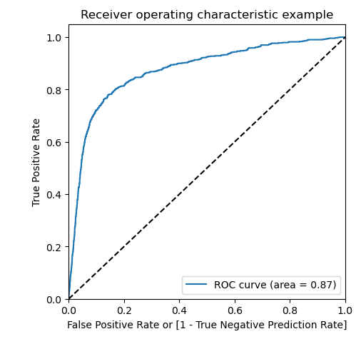
Explaining the results
• The AUC score for the training dataset is 0.90 and the test dataset is 0.87.
• This model can be considered as a good model.

Slide 18
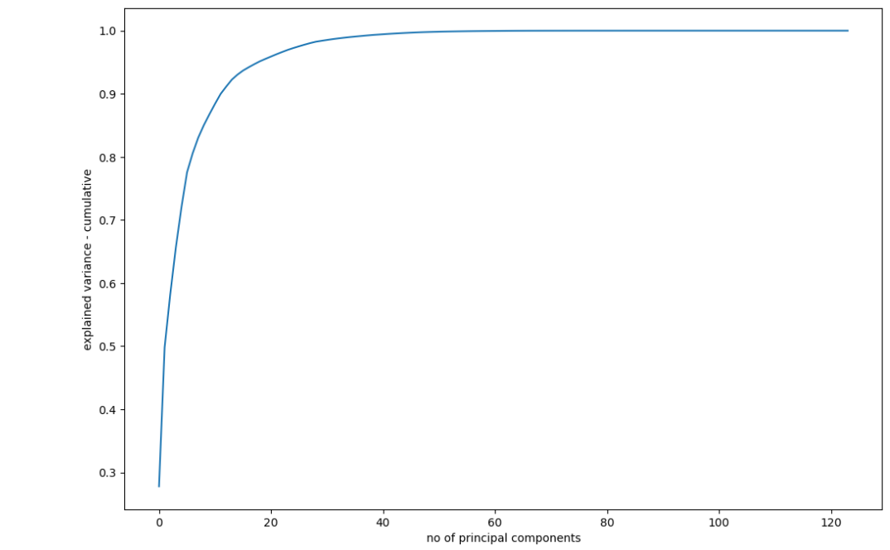
Performing Logistic Regression

Slide 19
Thank you
ANAMIKA SHUKLA

